Slide 1


Eric Qiao & Nicolas Newberry

Slide 2
Situation Overview
Recommendation: Purchase TargetCo
TEV
EBITDA
Multiple
IRR
2024 Transaction Structure
Revenue | 129
Entry EBITDA | 53
Enterprise Value | 846
Debt | 344
Equity | 502
TEV multiple | 16.0x
Debt multiple | 6.5x
Entry
$846M
$53M
16.0x
Base 5Y Exit Statistics
$1,817M
$114M
16.0x
18.08%
2029 Transaction Structure | Base case | Downside case
Organic Revenue | 190 | 183
EBITDA | 114 | 97
Organic | 85 | 69
Add-on | 29 | 28
TEV multiple | 16.0x | 15.0x
Enterprise Value | 1,817 | 1,458
MOIC | 2.3x | 1.5x
IRR | 18.08% | 8.63%
Downside 5Y Exit Statistics
$1,458M
$97M
15.0x
8.63%
Merits
Risks
Post-COVID air travel recovery
OEM backlogs
Defense spending headwind
Market leader with historically strong finances
Reverse engineering and backward integration
Aircraft retirements
Supply chain pressure
Multiple compression in a mature industry

Slide 3
Company Overview
Target lies in the aerospace and defense aircraft parts market, servicing two key categories
Business Description
Revenue Mix
TargetCo produces and sells a diverse, wide-range of component parts for commercial and military aircraft. These engineered parts typically fall within the structural and non-electrical category of an airplane.
TargetCo’s segments can be broken down into…
The Aftermarket that replaces parts for already existing aircraft, and
Original Engine Manufacturers [OEM] that require suppliers and manufacturers to produce new aircraft.
 | Aftermarket | OEMs
Commercial | 45% | 33%
Military | 10% | 12%
Divisions
Pumps & Controls
Connectors
Batteries
The Midwest facility producing proprietary pumps, compressors, valves, couplings, and mechanical controls – with a 70% sales concentration in the Aftermarket.
The West Coast facility producing tube connectors, clamps, heaters, and hoses – with a 70% sales concentration in OEM parts manufacturing.
The Southern facility producing batteries, individual cell replacements, and static inverters – with a 69% sales concentration in the Aftermarket.

Slide 4
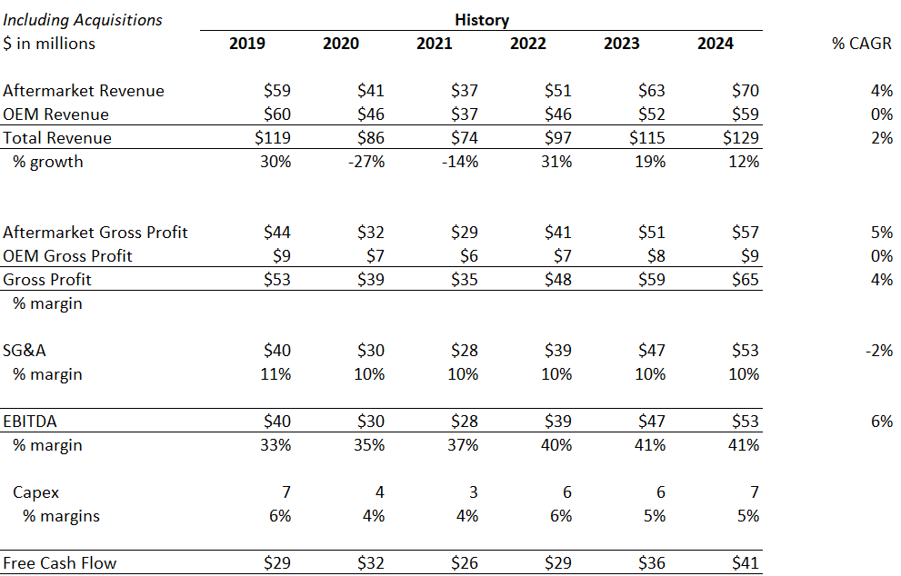
TargetCo’s Historical Financials
Major Events in TargetCo’s History
2015
Target spun-off from a conglomerate, carving out 4 key divisions
2017
Consolidation of 4 operating facilities into 2 factories to improve efficiency
2018
Add-on acquisition of the batteries segment closed
2024
Expected close of $70m business at 9x EBITDA

Slide 5


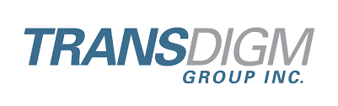



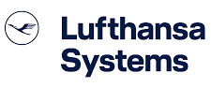
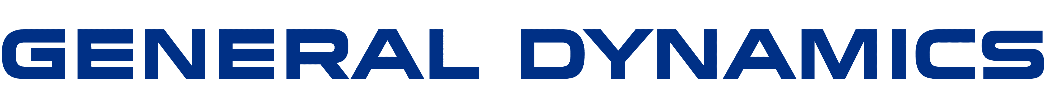
Aftermarket Overview
Business Model
Market Trends
The aftermarket manufactures replacement parts for commercial airlines, part distributors, and manufacturers. These cost-effective alternatives replace pricier repairs for worn-out components.
Performance tied to airline profitability.
Right to sell aftermarket parts are secured through OEM certifications and licenses.
New products are certified by FAA’s Parts Manufacturing Approval Process.
The aftermarket falls in the Maintenance Repair and Overhaul market [MRO] worth a total $94 B in 2023.
Concentrated revenue, with the top 6 customers capturing 60% sales.
Fragmented market broken into numerous, niche sectors worth $10 - $100 M comprised of many, small manufacturers.
Labor and raw material shortages slowing production.
Movement to new, more efficient and environmentally friendly fleets in the aviation industry, exiting COVID.
Industry & Customer Overview
Sources: IATA, Cascadia Capital Aerospace and Defense Industry Report, Grandview Research

Slide 6
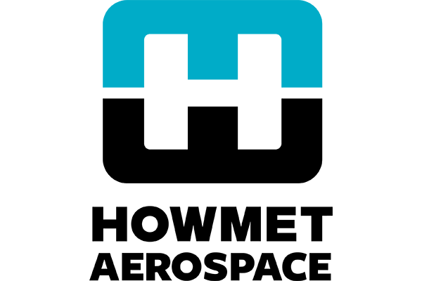

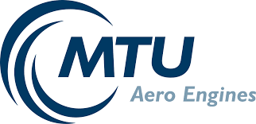

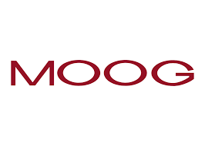




OEM Overview
Business Model
Market Trends
Parts suppliers manufacture components for OEMs, during the duration of an aircraft’s production lifetime. Target’s current contracts run for 3 – 5 years.
OEM parts contractors are rarely replaced, if they continue to meet performance standards set by OEMs and the FAA.
2023 aerospace parts manufacturing market was estimated at $915 B.
Highly fragmented market, with the average US commercial plane reported to source 200 tier 1 and 12,000 tier 2 or tier 3 suppliers.
High customer pricing power and concentration, with the top 10 customers representing 80% of Target’s sales.
Ongoing supply chain issues for OEM parts such as engine castings and aerostructures, creating missed aircraft delivery targets.
2024 machinist strike comprised of ~33,000 workers.
Key material shortages including titanium and steel.
Industry & Customer Overview
Sources: Grandview Research, Reuters, CNBC, Deloitte, Meisrow Investment Banking

Slide 7
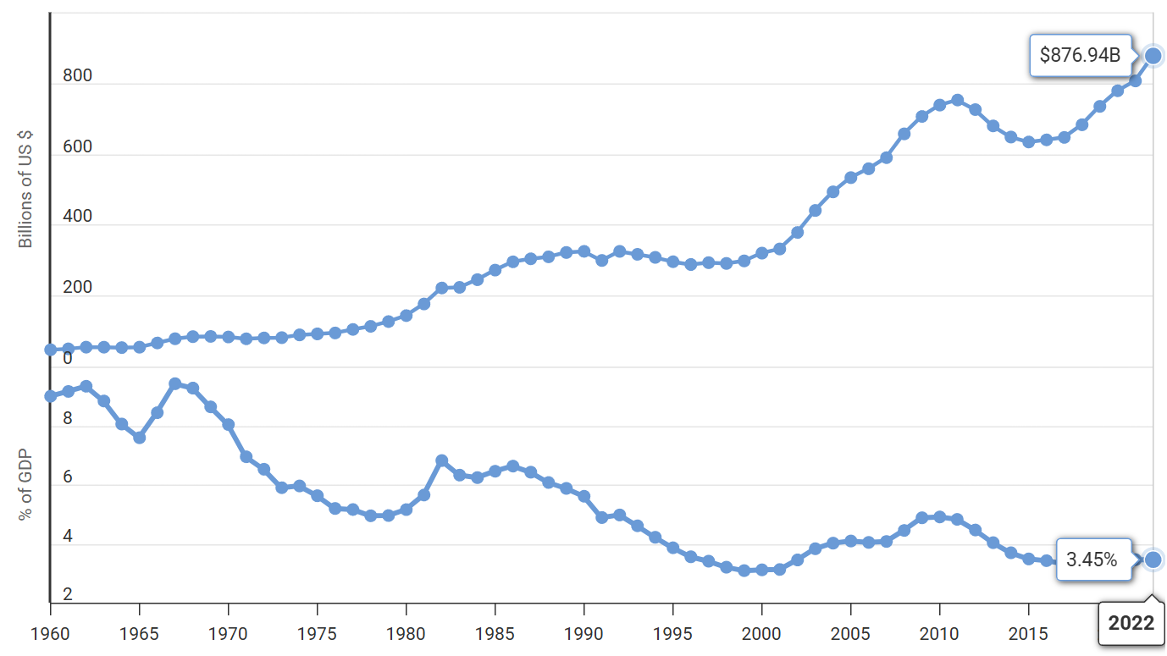
Commercial & Military Overview
The commercial aerospace segment can be split into the business and large jets.
Large Jets
Business Jets
Fixed-wing aircraft designed for high-capacity passenger or cargo transport over long distances, categorized into the wide and narrowbody fleets such as the Boeing 737 and Airbus A320.
Key customers include 1) AAR, 2) Availl [Boeing subsidiary], 3) Delta Airlines, 4) United Airlines… with performance dependent on cyclical consumer discretionary and travel expenditure.
Smaller, private aircraft tailored for private or corporate use, with a prioritization for luxury and speed, such as the Boeing Challenger and Gulfstream G650.
Key customers include 1) Gulfstream, 2) Bombardier, 3) Embraer…with performance dependent on business spending and the more stable, traveling demands of the wealthy.
During Covid-19, large jets experienced significant volatility with revenue growth falling 31.5% and 28.2% in 2020 and 2021 respectively, whereas business jets fell 26.1% and 6.8%. Whereas military aircraft is more stable…
Military
Military Spending & % of GDP (In Billions)
Military aircraft are utilized for combat and reconnaissance, emphasizing durability and speed, such as the Lockheed Martin F-35 and Boeing B-52.
Target’s key customers are the U.S. Department of Defense and American contractors such as 1) Lockheed and 2) Honeywell…
Military spending has remained relatively more consistent for Target than commercial aircraft, having grown at an annual rate of ~4.7% from 2015 to 2022, and representing ~3.45% of GDP.
Sources: Airbus, IATA, Global Jet Capital, Pitchbook, Jane Capital Partners

Slide 8
Aftermarket & OEM Segment Comparisons
The aftermarket has significantly higher margins relative to the OEM segment, contributing nearly ~88% of gross margin. The OEM business enables TargetCo to gain FAA approval to sell parts in the aftermarket. Target has been able to consistently raise margins in the aftermarket from ~72% in 2017 to ~81% in 2024, demonstrating continued pricing power.
OEM
Aftermarket
Historically, OEM revenues have been more stable than aftermarket revenues. Aftermarket revenues fell 29% in 2020, and subsequently rose 41% in 2022, and OEM revenues fell 23% and rose 23% during the same periods. With a more concentrated customer base, Target has less pricing power in the OEM business.

Slide 9
Merits & Risks

Slide 10
Merits Summary
1) Strong FCF Generation, Low Capex & High Margin Business Resistant to Market Downturns: Due to capital efficiencies and low investment requirements, TargetCo has maintained FCF upwards of $26 M even at the trough of the COVID-19 pandemic that set many airlines and parts manufacturers back. The continued need to replace and maintain aircrafts have fueled a steady aftermarket demand, even dating back to crisis before COVID. EBITDA margin remained high at 13% before and after 2011’s 9/11 and 2007’s Great Financial Crisis that negatively impacted air travel sentiments at the time.
2) Favorable Long Term Air Travel Trends: Air travel is expected to continue to see increased activity as discretionary spending is expected to grow. Long-term (2025-2035), CBO assumes real GDP growth averages 1.8-2.2%. Discretionary typically outpaces this slightly by 2-3% during expansion cycles, amounting to a ~4-5% 10-year CAGR. With increased discretionary spending, and with leisure spending expected to grow, this sets up an ideal environment for airlines to continue operating at capacity and as a result requiring more frequent repairs.
3) Strong Pricing Power & Reputational Moat: TargetCo already services many of the largest players in the commercial and military aircraft sector, building a reputation to service parts without failure. These networking effects creates an opportunity to introduce new component to directly care for their customer base’s needs. Target may expect to continue its pricing power in the aftermarket because PMAs still service as cheaper alternative to new OEM parts.
4) Sole Source Supplier & Strict FAA Guidelines: 1-3 crashes per year directly tied to defective parts out of 100 incidents globally. Safety concerns make it difficult for new entrants to gain FAA approval with ~$1-5M in costs and FAA approval turnaround time amounting to ~12-36 months. With TargetCo being a sole source provider for a many parts, customers work solely with Target to source parts. These events make it very risky for a customer to switch to a new provider. Creating a strong competitive advantage in costly switching costs.
5) Growing Fleets raising Future Maintenance needs: The influx of revenge traveling, utilization bouncing back after COVID, and geopolitical pressures has led to demand for larger fleets. The total commercial fleet that fuels Target’s aftermarket is expected double over the next year, which demand on both the aftermarket and OEM side of the business.
6) Aging Fleets require More Components: Pressure from OEMs failing to match new fleet delivery targets has forced commercial airlines and the Airforce greater reliance on older aircraft. The average age of commercial and military airplanes has risen to 15 and 29 years old, respectively, alongside growing backlog. The aging fleets straddled with heavy utilization boosts demand for maintenance, opening opportunities for new PMAs to be introduced as well.

Slide 11
Strong Financial Performance amidst Economic Downturns
Resiliency throughout COVID and stable finances provides an opportunity for debt-financed acquisitions
Drawback from COVID-19 that hurt many MRO manufacturers and airlines didn’t as negatively impact Target, given the acyclical nature of aircraft parts demand and the aftermarket particularly.
Strong Cash Generation
Target’s aftermarket costs consist of low manufacturing intensity and equipment need, with strong barriers to entry. This flexibility allowed scale back during COVID to increase liquidity cash on-hand.
Low Capital Expenditure Requirements
These factors have allowed Target to maintain healthy margins during the pandemic, with rising EBITDA and SG&A margins hovering at 30 – 40% and 10% respectively...
… looking further back during the Great Financial Crisis and 9/11, Target still experienced strong performance afterwards, with FCF and EBITDA CAGR of 7% and 13% between 2006 – 2024.
Notes:
Insulated by blah blah

Slide 12
Favorable Air Travel Trends
Post-Covid recovery continues to drive travel spending…
Strong travel trends are taking place as the industry continues to rebound from the Covid-19 shock, with continued momentum expected.
Travel spending projected at $1.2 trillion in 2025, a 5% rise from 2024, driven by a 9.7% jump in international arrivals at 85.2M. In 2024 total full year air traffic rose 10.4% with capacity rising 8.7%.
International air travel remains very strong with U.S. international traffic at 21.5M in Jan 2025, at over 108% of Jan 2019 levels. International air traffic rose 13.6% compared to 2023 and capacity rose 12.8%.
Expedia Gross Bookings (a measure of leisure spending) has stabilized back to 110.9 from 107.9 in 2019, demonstrating a full recovery from pre pandemic levels. Bookings have grown at 8.0% CAGR from 2022 to 2024.
Global business travel is expected to continue to grow, after growing 11.1% year over year, with projected increases of 10.4% in 2025 and 9.2% in 2026.
Sources: Vantage Market Research, National Travel and Tourism Office, GBTA & Mastercard, IATA, Statista
Notes:
Growing PMA acceptance attracts new customers
PMA approvals by the FAA have grown in recent years, with 2011 - 2015 versus 2006 - 2010 volume increasing by approximately 39%

Slide 13

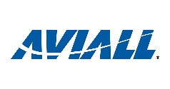



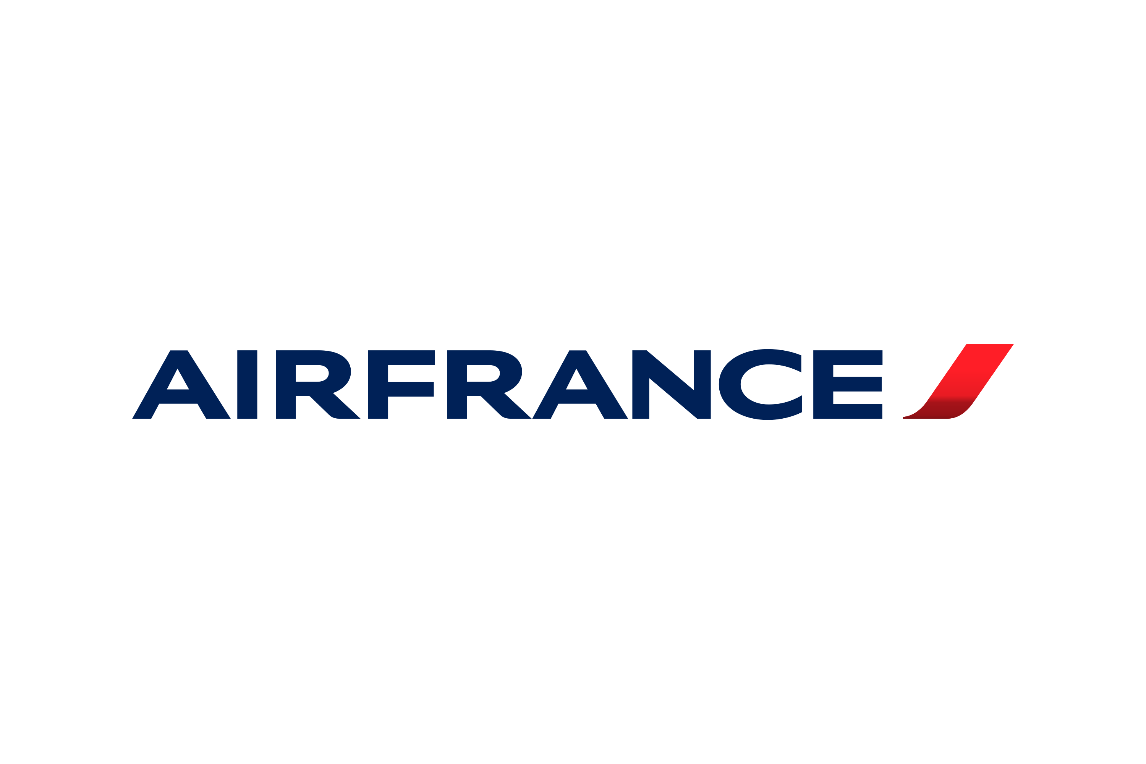



Strong Reputation unlocks Pricing Power and New PMAs
Target supplies parts to some of the largest players in the aerospace market
These established relationships create strong moat in a heavily scrutinized industry…
…alongside growing PMA acceptance attracting new customers looking for reliable suppliers, with FAA approval volume rising 39% from 2011 – 2015 versus 2006 – 2010.
Sustainable pricing increases paired with demand
Aftermarket producers have conducted rate hikes in the past because PMA alternatives for instance float at a 20% discount on OEM replacements. Although risk arises from potentially constraining relationships with OEMs.
Proven connections to airlines and military contractors provide TargetCo any opportunity to directly source and create replacement parts
Sources: Heico Company Reports, Alton, PMA 2016 Annual Conference
Notes:
Growing PMA acceptance attracts new customers
PMA approvals by the FAA have grown in recent years, with 2011 - 2015 versus 2006 - 2010 volume increasing by approximately 39%

Slide 14

Sole Source Supplier & Strict FAA Regulations Build Moats
Strong Market Position
70% of Target’s sales are sole source contracts with proprietary technology. There is no alternative for aftermarket parts, giving Target strong pricing power.
Within a fragmented market, no other player holds considerable share because the aftermarket is subdivided by product, forming numerous 10 - 100-million-dollar markets.
Their positioning has allowed Target to maintain very aggressive EBITDA margins growing from 30.3% in 2017 to 41.1% in 2024 alongside minimal CAPEX.
Strict FAA Guidelines
Recent events highlight risks associated with switching to smaller, newer aftermarket manufacturers.
The FAA aftermarket design & approval process takes 12-36 months. The seller needs to have supplied this part through an OEM before gaining this approval. This makes it very difficult for new entrants to enter the market.
PMAs cost $1-5M each making it difficult for others to replicate what Target is doing. Overcoming Target’s established relationships with end customers further enhances Target’s position.
Alaska Airlines flight 1282 (January 2025): Boeing 737 door plug blew off at 16,000 feet in the air. The plane conducted an emergency landing in Portland.
Southwest Airlines flight 2796 (March 2025): A Boeing 737 at Salt Lake City aborted takeoff due to a blown tire. Passengers deplaned on the runway and were bused to the terminal.
United Airlines flight 1722 (March 2024): A Boeing 787 from Denver to London diverted to Chicago after a passenger noticed a cracked window mid-flight.
Sources: National Transportation Safety Board, Federal Aviation Administration, UPI.com, Pitchbook
Notes:
foafd

Slide 15
Growing Fleet Matches Travel & Defense Trends
Demand for maintenance and aftermarket linked to heightened commercial flying and military aircraft
Mass Purchases after COVID
Key Drivers of Maintenance and Servicing Needs
To keep pace with future air travel, global airlines are expecting an expansion in the size of their fleets.
2043’s fleet will nearly be 2x 2023’s in-service airplanes, driven by the new purchases.
1a
Strong Recovery in Air Travel
Following the Covid-19 Pandemic, revenge travel has created heightened demand for commercial airliners. Lack of traveling beforehand saw the aftermarket’s prices and sales struggle. Today, global leisure and business air traffic saw a bounce back that has continued into 2024 and 2025 – with US travel spend projected to continue growing.
1b
Utilization of In-service Fleet
Loosened health restrictions has allowed for previously parked commercial aircraft to be used to at nearly full-capacity. The aerospace sector has seen usage matching or surpassing pre-COVID levels. Load factor rose from 70% to 83% between 2020 and 2023, with future projections set at ~85%, helping airlines (such as United and Delta) set records earnings in 2024.
2
Military Spending Catalysts
Rising, geopolitical tensions, because of continued conflicts such as the Ukrainian and Israel-Palestine war, has pressured countries to increase military budgets. The EU countries have become the latest to pursue rearmament packages. Domestically, the US may also look to spend, to ensure national security and shield the country from rising threats.
Sources: FAA, Naveo Consultancy, IISS, Forecast International Defense and Security Monitor, US Travel Association
Notes:
The large number of parked operating Increased will create upward pressure on airframes and engine maintenance that Target

Slide 16
Aging Fleets have Increasing Maintenance Needs
OEM production delays and backlog has forced airliners to delay retirement of older, less efficient planes.
The largest OEMs [Airbus and Boeing] have dealt with supply chain and regulatory issues, severely delaying new deliveries and leading to extended aircraft lifespans.
Amidst rising utilization, persistent future production issues has caused implied production years for most popular aircraft to rise, increasing probability of future delays.
The global commercial fleet reaching a record high average age at ~15 years. Alongside time to clear backlog rising, with the A320neo and Boeing 737 Max rising from 5.8 to 9.7 and 5.7 to 8.1 years of backlog, respectively.
The Airforce inventory has shrunk by ~10% between 2000 – 2021, while the average age of U.S. military aircraft is forecasted to rise by 6 years between 2024 – 2032.
The aftermarket is positioned to take advantage of aging fleets
The aftermarket profits from aging aircrafts that require more frequent and extensive maintenance.
PMA parts for instance see increased demand between age 13 – 22 years, after OEM Long-Term Agreements expire approximately around year 10.
Sources: Boeing 2024 Commercial Market Outlook, IATA, Cirium, U.S. Global Investors; Airbus, Boeing, Alton, PWC, CIBC Capital Markets

Slide 17
Risks & Mitigants Summary
1) Consumer Confidence & Spending Slowdown: Consumers are still feeling the pain from elevated inflation, with Delta cutting Q1 revenue forecasts, citing weaker leisure and business bookings, and Walmart and Target slashing 2025 profit forecasts.
Mitigating Factors: In the short term there may be some level of volatility, in the long run, there is a very favorable setup for continued air travel. Target's business is very insulated to short term changes in consumer spending and has historically been recession resistant.
2) Renewed Fleet Retirement: Retirements, particularly from the commercial airline sector, were heavily delayed during COVID-19 and is expected to return. The older fleets will be replaced by the longer-lasting B737Max and A320neo, alongside USMs [another OEM part alternative] benefitting from a future influx of parts.
Mitigating Factors: The positive tailwind from new deliveries will surpass retirements, as the global commercial fleet is expected to double over the next 10 years. Optimism on early or on-time retirements may not be met, considering the recent string of Boeing and Airbus malfunctions.
3) Supply Chain Instability & Tariff Risk: The looming implementation of 25 – 50% metal tariffs may only add to the raw material costs that have plagued the MRO industry. Factoring in as well a persistent labor shortage has driven MRO wages up 7.3% from 2023 to 2024, Target may continue to experience margin pressure.
Mitigating Factors: Target has been able to maintain rate hikes above rising costs to either breakeven or ~4% greater in recent years, despite supply chain concerns plaguing the A&D industry – the ability to service more cost-effective components than new OEMs, alongside the potential introduction of new PMAs has created this barrier.
4) Reverse Engineering and Concentration: With low CAPEX and R&D spend of $6 M and $3 M respectively, new players may enter with even cheaper manufacturing costs than Target. This may accentuate how concentrated Target’s customer base is with the top 10 customers comprising of ~40% of sales, and how the aftermarket’s recent sales are dependent on 2 key products for ~60% of 2024 sales.
Mitigating Factors: New PMAs are still a developing part of the OEM alternatives sector, comprising less than 5% of revenues. Furthermore, Target’s testing capabilities to pass FAA standards creates indirect barriers to entries that cannot be easily overcome.
5) Backward Integration Risk: Boeing and Airbus are focused on growing their aftermarket business. Airbus aims to triple aftermarket revenue to €9B by 2027 from €2.8B in 2017. Meanwhile Boeing plans to scale its MRO subsidiary, BGS which sells parts and repair services, to $50B in revenue by 2027.
Mitigating Factors: If Boeing continues to sell to its customers in the aftermarket, it may lose pricing power as its larger customers have more power to negotiate on price, additionally, large airlines will have to replicate and start selling a wide variety of different parts like Target. A large portion of their aftermarket sales are for parts which are used but in serviceable condition which doesn't always compete with Target, it may take a lot of investment and a shift in strategy for large OEMs to be a serious competitor.
6) Technology Disruption Risk: New 3D printing companies are innovating how the aftermarket creates parts. Targeting multiple industries and offering faster turnaround along with cheaper parts. This may present a risk to Target, as Target mainly supplies non-essential parts to airlines.
Mitigating Factors: TargetCo is a sole source provider for 70% of parts. A customer would have to trust a new 3D printing company is supplying high quality parts to gain its business. Moreover, many large 3D printing businesses (DDD, SSYS, and XMTR) are cash flow negative and rapidly burning cash. It may be difficult for them to make the investment to gain FAA approval on parts and be competitive on price. The industry has not yet proven to be profitable.
7) Increasing Competition from other PE Firms: Consistent deal activity within the whole aerospace and defense space has been seen, with the components manufacturing businesses being targeted particularly. Other players are beginning to realize returns from Aftermarket investments.
Mitigating Factors: High market fragmentation amongst the numerous product markets create supply for Target’s add-ons. Target’s leading market position paired with a strong financial base to support more debt-transactions, alongside a 2025 acquisition in play, shows an M&A strategy.
8) Management Legal Issues: Mr. Downey has had issues in the past with the law after a minor misdemeanor occurred. His history may represent the company poorly when dealing with customers, we can mitigate this risk by firing him or further evaluating him. Overall, this incident happened 12 years ago, and it is very unlikely that it will have any material impact post-acquisition. We don't see it presenting any serious risk to the business.

Slide 18
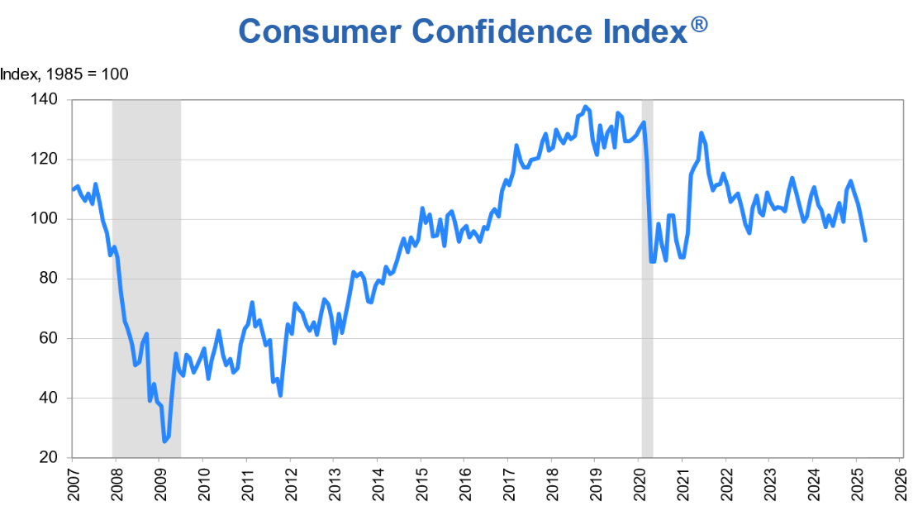
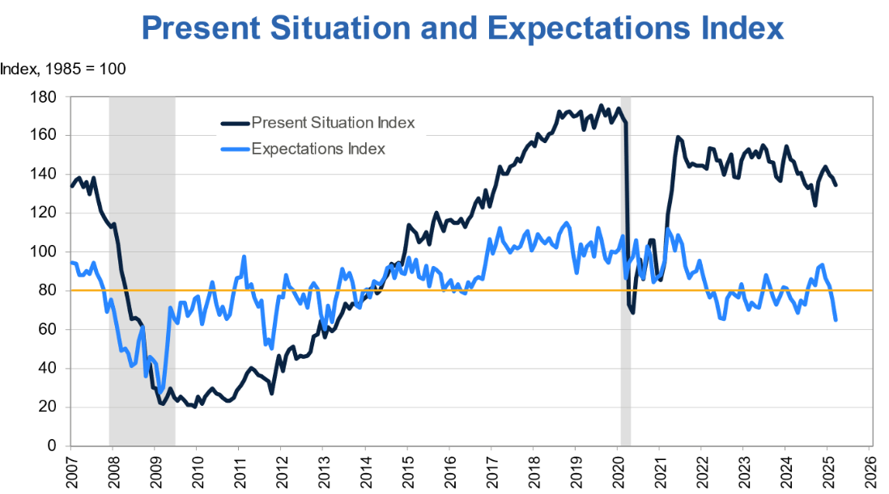
Recessionary Fears Negatively Impact Air Travel
Low consumer confidence may potentially reduce discretionary spending…
Consumer confidence fell 7.2 points in March to 92.9. The lowest value since the Covid-19 pandemic.
Consumer expectations index—a measurement of short-term outlook for income, business and labor market conditions—dropped 9.6 points in March to a 12 year low at 65.2. When it drops below the 80 threshold (orange line) it is a recessionary signal.
Mitigating Factors
Despite fears of a looming recession, the U.S. inflation rate has come down significantly, from its peak at 9.1% in 2022, down to 2.8% in 2025, as the consumer continues to recover and adjust from previous price increases.
This is a short term, temporary risk. The business has historically withstood recessionary periods. While air travel is relatively volatile, the aftermarket business is not, as airplanes will always need servicing. Furthermore, the long list of plane backlogs provides even more stability for replacement needs, should air travel slow down.
Source: US Conference Board, Statista

Slide 19
Retirement of Older fleets are Expected to Increase
OEM production and legacy aircraft retirement may ramp up in the next 5 years
Retirement was temporarily restrained during COVID, with the annual passenger removal rate falling by ~50% for 2020 – 2023 versus 2010 – 2019. Alongside mass orders, demand for new aircraft will replace maintenance-heavy, aging fleets.
The more durable A320neo and 737Max will look to replace older generations.
USMs, that competes within the aftermarket with an OEM discount of 20 – 60%, can expect a supply of stock, which previously was in shortage and driving USM costs.
Mitigant: Deliveries of next-gen aircraft will outpace retirements by a projected 150% in 2029
Mitigant: Airbus and Boeing production have historically stalled, alongside fleets retire with less remaining life
Safety concerns regarding the A320neo’s CFM-1A and PW1100G or Boeing CFM-1A engines continue to plague both OEMs, leading to persistent groundings and potentially future slowed retirements.
As recently as mid 2024, Airbus reduced FY delivery target by 4 aircraft due to supply chain concerns.
Retirement of older fleets tore down for USMs will limit the available green-time and usability of these parts.
USMs may also reduce Target’s component costs.
Sources: Airbus Guidance Update, Alton, Boeing Commercial Market Outlook, Naveo Consultancy
Source:

Slide 20
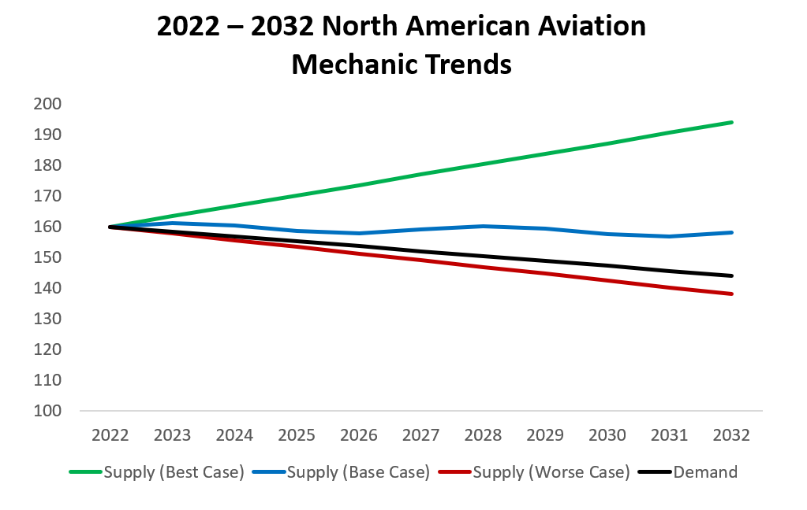
Supply Chain Instability for OEMs and Component Parts
Renewed Raw Materials Pressure from Global Tensions and Tariffs
MRO raw material prices already rose 8.3% between 2023 to 2024.
Moreover, the Trump administration has already implemented a 25% aluminum and steel tariff, with threats to continue raising rates, which will hurt Target’s high margins.
The US is already heavily reliant on Canadian and Mexican metal, with 91% and 41% of 2021 titanium and aluminum imported, respectively.
Mitigant: Titanium tariffs have not been announced or put in motion. Moreover, the Trump administration and its tariff policy has seen increasing scrutiny domestically and abroad, with implementation delays seen already.
Other
7%
Titanium
5%
Aluminum
4%
Steel
2%
Nickel
3%
All Metals comprise 20% of Target’s Revenue
Skilled Mechanics Shortage Suppresses Production
For both OEM and Aftermarket manufacturers, labor demand has exceeded supply. The shortage was heightened by a growing labor movement away from manufacturing, an aging workforce, and COVID disruptions. Creating expectations for MRO wage pressure, with labor costs up 7.3% worldwide in 2023.
Mitigant: Potential optimism exists for a recovery in labor post-covid, due to a rise in certified active merchants and enrollment gains for US Aircraft Maintenance Technician Schools [ATMS].
Mitigant: Target has historically been able to pass these cost pressures onto customers in the Aftermarket, even throughout the pandemic, with some success for the OEM market as well.
Target’s ability to serve as a reliable, cheaper alternative to new OEM parts, in the Aftermarket, has created a pricing moat above inflation.
Long-term OEM contracts price in cost increases.
Target’s YoY Aftermarket Price vs Cost Mix
Source: Tax Foundation, FAA, Oliver Wyman, US Bureau of Labor Statistics

Slide 21
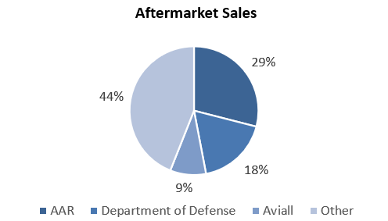
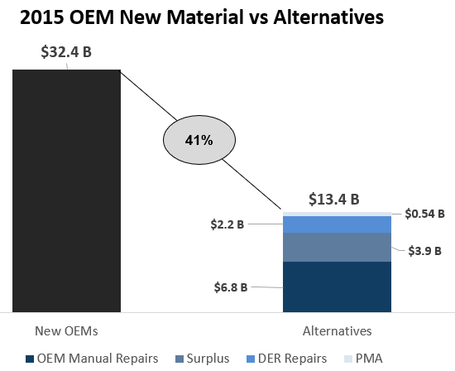
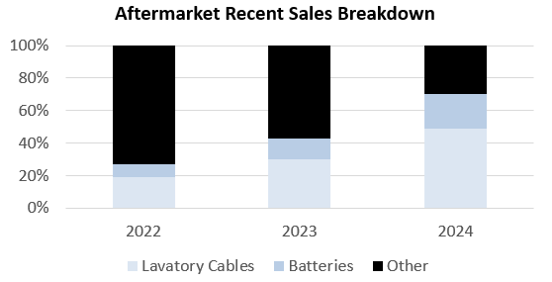
PMA Reverse Engineering & Customer Concentration Risk
Inexpensive investment requirements invites new entrants to engineer substitutes…
Target’s component parts require minimal extensions and maintenance, boosting margins but lowering barriers to entry. With annual R&D amounting to only $3M and CAPEX comprising 4 – 6% of sales, costs have been suppressed historically.
… replication of cheap products would amplify Target’s recent reliance on a few players and products.
Customer Concentration
Mitigant: However, heightened by a series of airplane incidents in 2025 and growing pressure on the FAA, TargetCo will have an advantage with its testing procedures and equipment. Moreover, PMAs present a small risk and opportunity, representing only a portion of the total MRO materials sector.
Both segments rely heavily on a few major customers, with 38% of all sales dependent on 10 customers.
Product Concentration
Most of the aftermarket’s recent, new business is concentrated in lavatory cables and batteries, combining for ~65% of 2024 sales.
Sources: PMA 2016 Annual Conference

Slide 22


Backward Integration from Large OEMs
Increased Aftermarket Competition from large OEMs, such as Boeing and Airbus actively exploring options to expand into their supply chain, may erode Target’s market position.
BGS, launched in 2017, consolidates Boeing’s aftermarket offerings—parts, MRO, digital analytics, and training—across commercial and defense sectors.
In 2024, BGS reported $19.2B in revenue, up from $18.5B in 2023, showing steady progress toward the $50B goal.
Boeing acquired aerospace parts distributor (KLX) in 2018, showing intent to gain control over the supply chain.
BGS aims to grow PMA sales from $1.5B (est. 2024) to $2B in 2025, targeting a 25% increase.
Satair—an Airbus subsidiary—stocks 1.5M+ parts and aims to grow PMA sales to €500M by 2025, cutting reliance on third-party suppliers like TargetCo.
In 2024 Airbus launched a “Component On Demand” service that integrates its own PMA and UMS (used serviceable material) into a one-stop shop for its customers. offering new and used parts for A320, A330, A350, and A380 fleets with guaranteed availability. Competing with TargetCo for Airbus replacement parts.
Mitigating Factors
OEMs are targeting the aftermarket for its high margins and returns, but their dual role as jet manufacturers may weaken their negotiating leverage, as airlines demand bundled discounts on parts and services.
TargetCo is a sole-source supplier for ~70% of the parts they supply. replicating them will be very costly, even for larger companies. Strong relationships formed by FAA certifications and Target’s strategic offerings for low-cost, simple versus OEM’s life-limited, highly engineered parts may make it more difficult for large OEMs to enter the market.
Sources: Boeing, Airbus
Notes:
Growing PMA acceptance attracts new customers
PMA approvals by the FAA have grown in recent years, with 2011 - 2015 versus 2006 - 2010 volume increasing by approximately 39%

Slide 23


Emerging Technology Disruption Risk
3D Printing Technology Presents a Significant Risk
Customization & Speed: 3D printing (additive manufacturing) allows on-demand production of complex parts without tooling, slashing lead times from weeks to days. Xometry, for example, offers parts in as little as 1 day.
Cost Efficiency: No molds or minimum order size reduces costs for low-volume runs, ideal for aftermarket spares.
Quality & Accuracy: Industrial-grade printers (e.g., HP Multi Jet Fusion, EOS DMLS) achieve tolerances of ±0.1 mm, rivaling CNC machining, with materials like ULTEM 1010 matching aerospace specs.
Capabilities: Xometry offers eight 3D printing processes (e.g., SLS, FDM, DMLS, MJF) across 60+ materials, including aerospace-grade ULTEM 9085 and titanium. Its AS9100D and ITAR certifications align with FAA standards, matching TargetCo’s niche.
Aerospace Push: Partnerships with NASA and a 2024 Asia-Pacific deal for 7 figure parts shows aerospace traction.
Capabilities: Materialise specializes in certified aerospace 3D printing, offering SLS and metal AM for Airbus A350 parts. Its Magics software optimizes complex designs.
Aerospace Push: Partnered with Proponent in 2021 and Stirling Dynamics in 2025 to supply MROs with cabin spares, targeting on-demand digital supply chains.
Mitigating Factors
New startups looking to be competitive, producers of aerospace parts still need to pass FAA standards…
With 3D printing remaining a relatively new product, quality and testing concerns exist that may make non-3D printed counterparts more attractive still.
FAA approval costs added on top of 3D company’s high cash usage to improve its technology can damper ROI in an already mature market.
TargetCo’s market position is bolstered by its diverse, wide variety of parts and part sizes that makes 3-D printing replication costs expensive.
Sources: Xometry, Materialise, Deloitte
Notes:
Alongside, TargetCo’s business model spanning numerous aerospace parts, the loss of several product lines from new competition is inevitable, but can be remedied through TargetCo’s new PMAs.

Slide 24









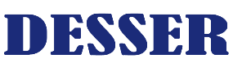

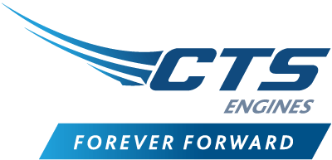




PE Roll-ups Create Buy & Build Competition
With the aftermarket and OEM parts markets decentralized, competition for M&A targets can be expected
2020 – 2023 Q4 MRO and PMA Aftermarket Acquisitions
8 Investments
3 Investments
PE Investors
13 Investments
Aerospace & Defense Electronics
5%
Component Manufacturing
56%
Support Services & MRO
19%
Defense IT & Technology
29%
Overall, the entire A&D industry has seen deal volume
Mitigant: Target will look to reduce bidding wars with its strong market position, high FCF generation, established relationships across the supply-chain, and its own aggressive add-on acquisition strategy under a new owner. Moreover, Target is already currently looking to realize a $7M EBITDA acquisition at a 9x multiple by 2025.
Source: Cascadia Capital Aerospace and Defense Industry Report, PitchBook
Notes:
PE funds successfully executed the buy and build strategy

Slide 25

Operating Model

Slide 26
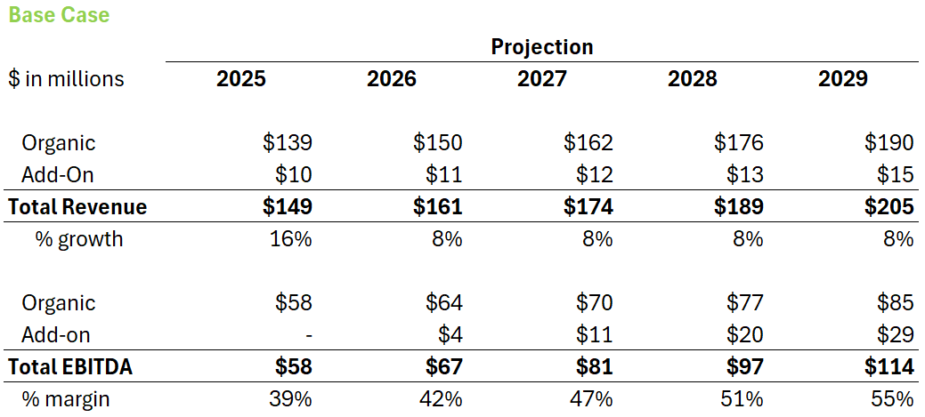
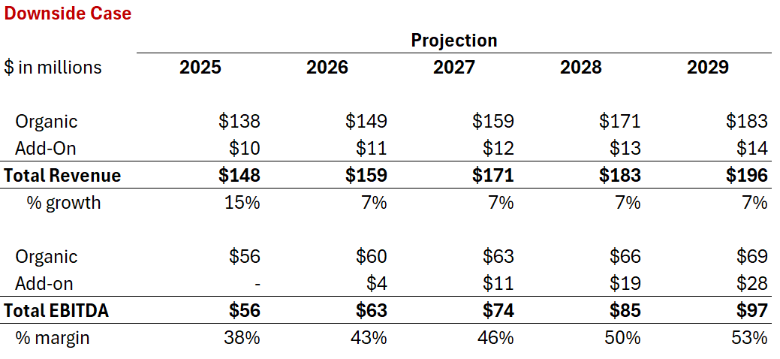

Organic Base versus Downside Case with Acquisitions
Base Case Key Drivers
Commercial aircraft boosted by OEMs backlog and future deliveries.
Growing defense spending in response to geo-political tensions.
Continued Aftermarket pricing power from FAA barriers to entry and Target’s sole source manufacturing.
OEM contracts break-even with minimal compensation from input cost increases.
Downside Case Key Drivers
Continued labor shortages and metal cost pressures.
Post-COVID air travel recovery slows alongside recessionary fears.
New entrants arrive due to the nature of Target’s low production costs.
Large OEMs renew their expansion into the more profitable aftermarket.
OEMs pick up production, enabling older aircrafts to be retired.

Slide 27
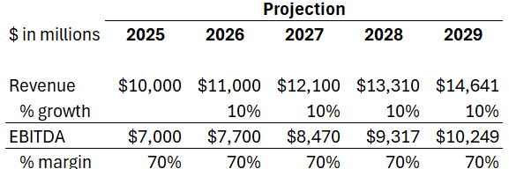
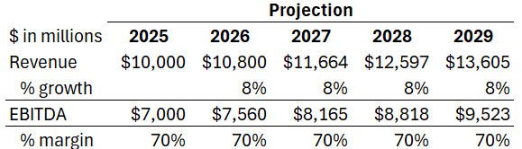

Aftermarket Add-ons Contribute ~25 – 30% of 2029 EBITDA
Target’s 2025 $7M EBITDA acquisition at 9.0x multiple alongside public comps drove add-ons calculations
Assumptions and Projections
Target will pursue an aggressive M&A strategy, executing 1 acquisition yearly, following the realization of the 2025 add-on.
EBITDA was held constant at $7M, following the size of Target’s most recent transaction.
Revenue growth would be set at a 1% step up to the core business’s growth, to reflect potential realizable synergies.
CAPEX as a percentage of sales is forecasted to be 1% higher than that of the core business. Given that the target would be less efficient in its operations in the short term.
Multiple = Average (Public Aftermarket Comps, 2025 Acquisition) + 1.0x to reflect competition to achieve strong targets.
Base at 12.0x & $14.6 M
EBITDA
Downside at 13.0x & $13.6 M
EBITDA
Notes:
12.44; 15.68 and average with 9x, to get 12x multiple; synergies + inefficiency capex; acquisition every year, except for 2025, which is coming up in

Slide 28
Base Case Revenue & Margin Projections
Revenue: We projected revenue growth to decrease from 11% in 2024 to 9% in 2029 on the backdrop of slower post Covid spending and recessionary fears, partially offset by the historically recession resistant business model, and increased defense spending due to elevated global geopolitical tensions.
Gross Profit: We forecasted increasing gross margins from 51% to 53% from 2024 to 2029, as TargetCo sees strong pricing power largely driven by aftermarket pricing power increasing in line with historicals and increased aircraft age & maintenance repairs. Partially offset by a threat of new entrants, and tariffs.
SG&A: We decreased SG&A as a percent of sales slightly from ~10% in 2024 to ~9% in 2029. Roughly in line with historical results. We see continued leverage in SG&A as it remains relatively fixed.

Slide 29
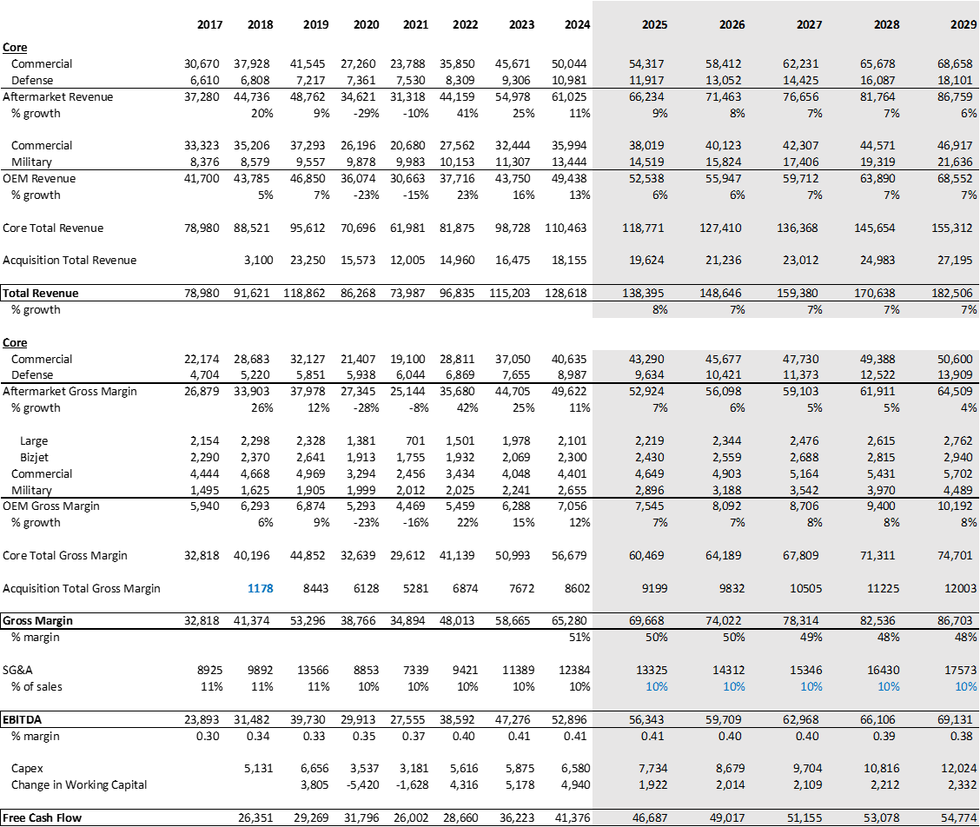
Downside Case Revenue & Gross Margin Projections
Revenue: We projected revenue growth to decrease from 11% in 2024 to 6% in 2029 on the backdrop of slower Post-Covid spending after an elevated recovery environment as well as recessionary fears. These effects are partially offset by a recession resistant business model and increased defense spending due to elevated global geopolitical tensions.
Gross Profit: We are forecasting decreasing gross margins from 51% in 2024 to 48% in 2029 as TargetCo sees pressure on COGS due to tariff driven inflation & supply chain issues, and competition on pricing as large OEMs continue to invest in their aftermarket capabilities.
SG&A: We kept SG&A as a % of sales in line with the current year as inflation driven by tariffs is likely to keep costs high.

Slide 30
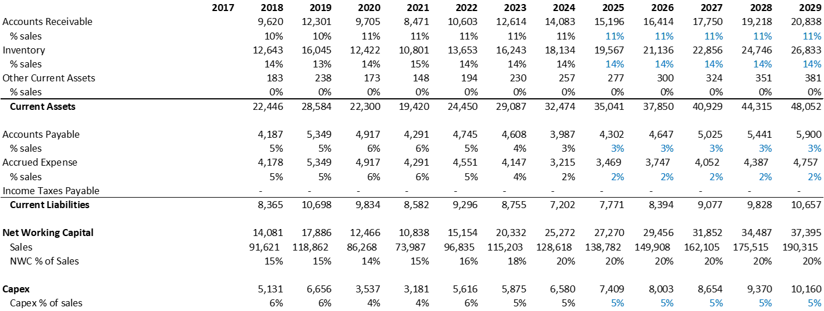
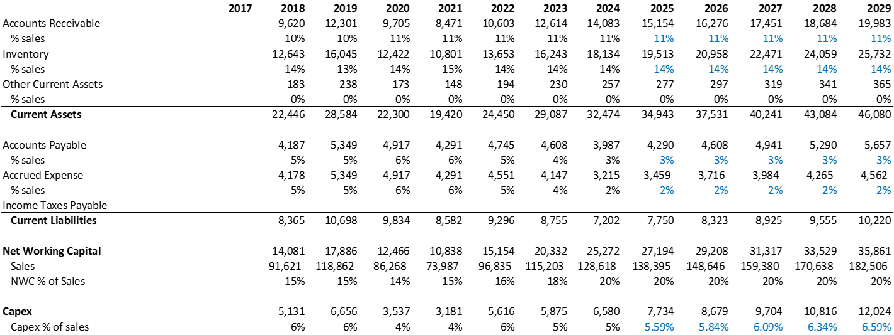
Balance Sheet Projections
Base Case
Working Capital: NWC was kept in line with historical margin at 20% of sales in both cases.
CAPEX: Low capital investment as Target has a good relationship with the FAA and a strong OEM presence, allowing them to sell parts in the aftermarket with minimal incremental investment. In our downside case, we believe that Capex will increase due to new emerging technologies (3D Printing) taking share, forcing Target to increase its capital investments to remain competitive. Partially offset by the fact that they are sole source providers for most parts, and hurdles involved in the competition gaining FAA approval.
Downside Case

Slide 31
Forecast Period Aftermarket vs OEMs
We grew the aftermarket in response to management’s decision to focus heavily on the more profitable Aftermarket segment of the business…
OEM
Aftermarket
Base Case Key Drivers
Downside Case Key Drivers

Slide 32
Forecast Period Commercial vs Military
A continued rebound from COVID and OEM’s production delays fueled the commercial sector, whereas defense spending would grow at a more conservative, but steadier rate…
OEM
Aftermarket
Base Case Key Drivers
Downside Case Key Drivers

Slide 33
LBO Mini-Model

Slide 34
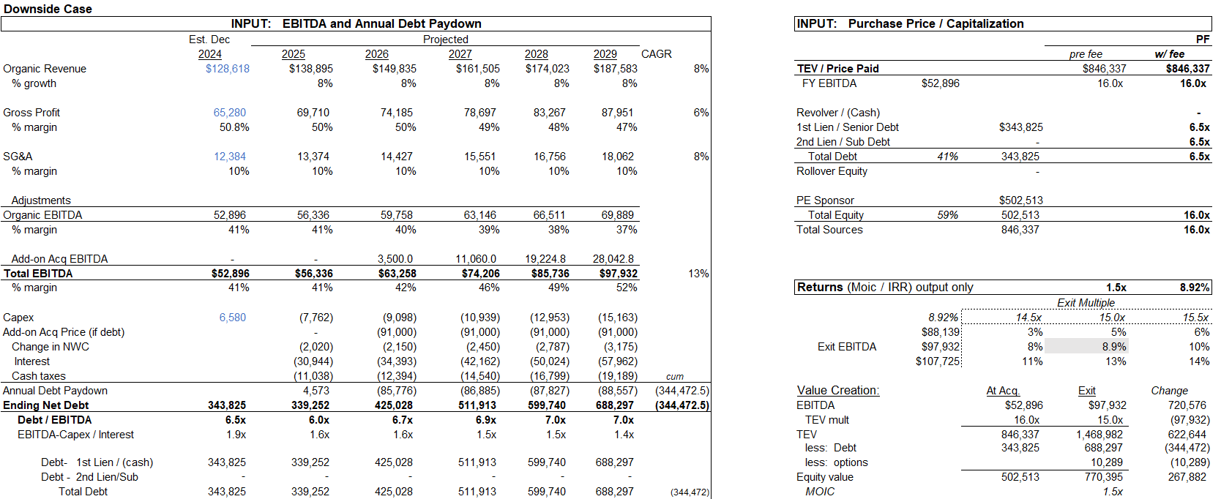

Base Case LBO
The exit multiple was set equivalent to the entry multiple, reflecting potential risks such as supply chain or reverse engineering becoming more prevalent after a 5-year holding period.

Slide 35
Downside Case LBO
Multiple compression was baked in because investors may demand a discount, given Target’s long-trading history with 2 PE sales, alongside reduced opportunities for operational efficiency gains, after further maturing by 2029

